Slide 1
Routing Services Transition for lower environments October 2017

Slide 2
Agenda - Delivery
Definition
Diagram
Example issue/request and requirements
How To:
What do I need access to?
How do I access log files?
What do I look for within a log file?
Assumptions/pre-requisites
Step-by-Step instructions

Slide 3

Definition
Product Overview:
Routing Services is a in house routing Database which is used to route to a particular business segment.
In Support of:
CVP currently supports multiple lines of business – UHC, Optum
Supported By:
ECD Design and DeliveryTeam - Enterprise Call Delivery <Enterprise_Call_Delivery_DL@ds.uhc.com>
Prod Application Environment:
Enterprise Call Delivery <Enterprise_Call_Delivery_DL@ds.uhc.com>
Dev Application Environment:
Enterprise Call Delivery <Enterprise_Call_Delivery_DL@ds.uhc.com>

Slide 4
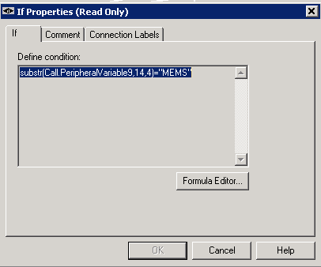
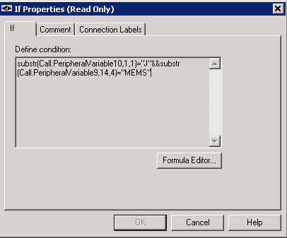
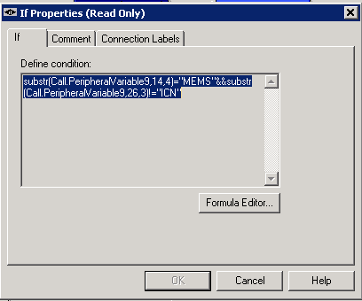
Where Routing Services fits in the environment
10,1,1 is used for Natural language
9,14,4 is used for MEMS app
9,26,3 is when we have MEMS app
And ICNI callflow is not included

Slide 5
CCS/CVP Integrations – Close Up

Slide 6
How To:
What do I need access to?
To query this database you will need access to the global group UHT_ICM_DBAccess, ICM_HDS_Reporting via secure request.
To access Routing Services lower environments
Dev Routing Services: http://webet0207/RoutingServices/Dev/QuickEdit.aspx
PreProd: http://workintake-stg.uhc.com:9090/RoutingServices/PreProd/
Group Access for Routing Servcies: RoutingServices_Web and OptumRouting_Web_Admin via Secure
For ICM AW access you need to request for ICM_AW_users_ARK (for Secondary ID)

Slide 7
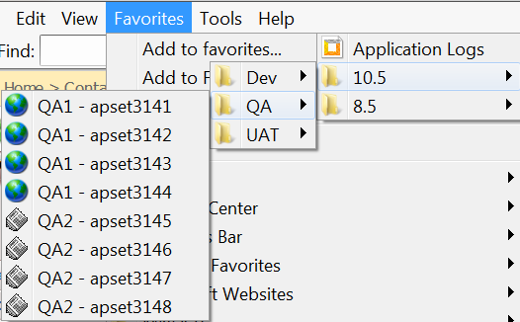
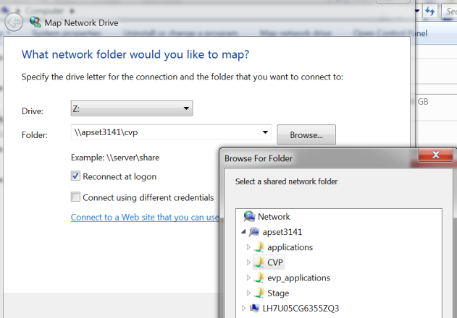
How to – part 2:
How do I log in?
Create file links, and save as Favorites - \\apset3141\cvp
Alternatively - map network drive.

Slide 8
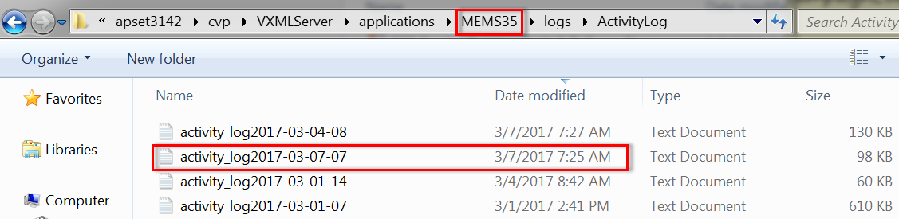
How to – part 3:
Access application log.
May need to look at a few servers to find the one hosting the application of interest.
Application & version obtained from routing services application (see references section).
\\<server>\cvp\VXMLServer\applications\<appName&version>\logs\ActivityLog
Locate correct log by date/timestamp, or search for ANI or test data used during call.
Evaluate log detail:
Search for key words:
“utterance”
“Check_Authenticated”
“IscampaignCodeNull”
Caller authentication.
Conversation Manager interaction.
Call variables being set.
See Voice User Interface (VUI) diagram links in reference section for questions on a specific IVR application’s call flow.

Slide 9
How to – part 4:
Anatomy of a call activity log:
Each call is enveloped with “newcall” and “end,duration” entries:
10.106.175.246.1492704919284.210.MEMS45,04/20/2017 11:15:19.284,,start,newcall,
10.106.175.246.1492704919284.210.MEMS45,04/20/2017 11:16:50.676,,end,duration,91
Everything in between represents the application processing logic associated with the call.
Refer to Voice User Interface (VUI) diagram for questions on a specific IVR application’s call flow.
Note - there will be information written to the call log that won’t be reflected in the VUI.
Evaluate log detail:
Search for key words (can vary between applications):
“utterance”
“Check_Authenticated”
“IscampaignCodeNull”
“GetLSCmByMid”
Caller authentication.
Conversation Manager interaction.
Call variables being set.

Slide 10
How to – part 5:
A log file may contain entries from many calls. Each call is enveloped by a start and an end:
10.106.175.242.1489145945109.28.MEMS35,03/10/2017 05:39:05.109,,start,newcall,
10.106.175.242.1489145945109.28.MEMS35,03/10/2017 05:39:41.892,,end,result,normal
Log sample 1 (happy path):

Slide 11
How to – part 6:
Log sample 2 (failed authentication):

Slide 12
References – CVP 10.5 Non-Prod Server List:
Environment, simulator number, and associated servers are shown below.
Contact IVR Dev team for additional support.

Slide 13
References – VUI links:
UHC - http://it-ics.uhc.com/sites/CCS/VPProjects/UHC/Forms/AllItems.aspx?RootFolder=%2fsites%2fCCS%2fVPProjects%2fUHC%2fIVR%2fProduction%20Applications&FolderCTID=0x01200055BC5C93320C85409FAB35B21B0D1367&View=%7b96DC053F%2d4EEA%2d46E3%2dB787%2d4057F282283B%7d
OptumNL - http://it-ics.uhc.com/sites/CCS/VPProjects/OptumHealth/Forms/AllItems.aspx?RootFolder=%2fsites%2fCCS%2fVPProjects%2fOptumHealth%2fIVR%2fProduction%20Applications%2fOptum%20Natural%20Language&FolderCTID=0x012000640F66C78C25B84F92205F18BDA0DDC5&View=%7b958F3A96%2dA792%2d4ABA%2dB1CE%2dF9C300655F3E%7d
Optum Health - http://it-ics.uhc.com/sites/CCS/VPProjects/OptumHealth/Forms/AllItems.aspx?RootFolder=%2fsites%2fCCS%2fVPProjects%2fOptumHealth%2fIVR%2fProduction%20Applications&FolderCTID=0x012000640F66C78C25B84F92205F18BDA0DDC5&View=%7b958F3A96%2dA792%2d4ABA%2dB1CE%2dF9C300655F3E%7d
OHCA - http://it-ics.uhc.com/sites/CCS/VPProjects/OptumHealth/Forms/AllItems.aspx?RootFolder=%2fsites%2fCCS%2fVPProjects%2fOptumHealth%2fIVR%2fProduction%20Applications%2fOHCA%20%28Optum%20Advocacy%29%2fVUI%20Design&FolderCTID=0x012000640F66C78C25B84F92205F18BDA0DDC5&View=%7b958F3A96%2dA792%2d4ABA%2dB1CE%2dF9C300655F3E%7d

Slide 14
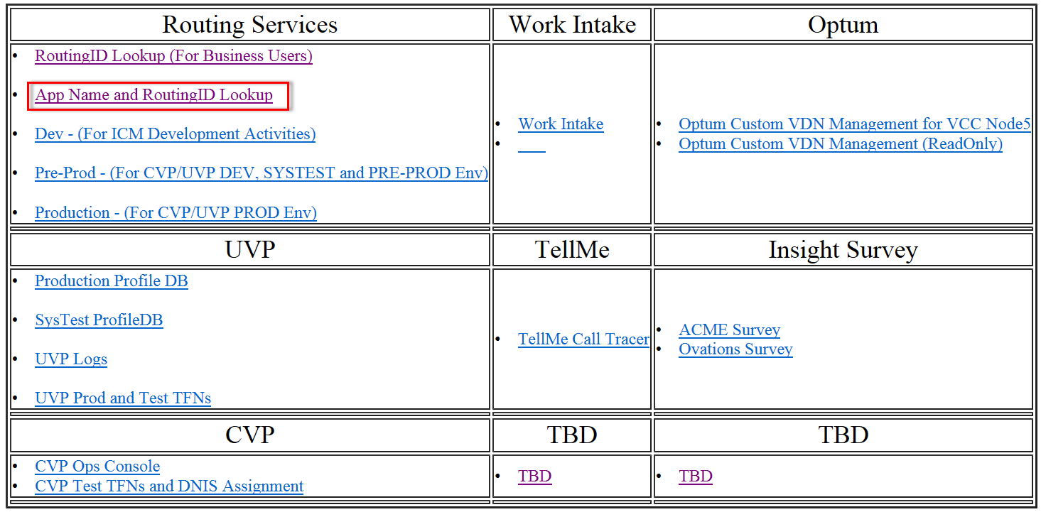
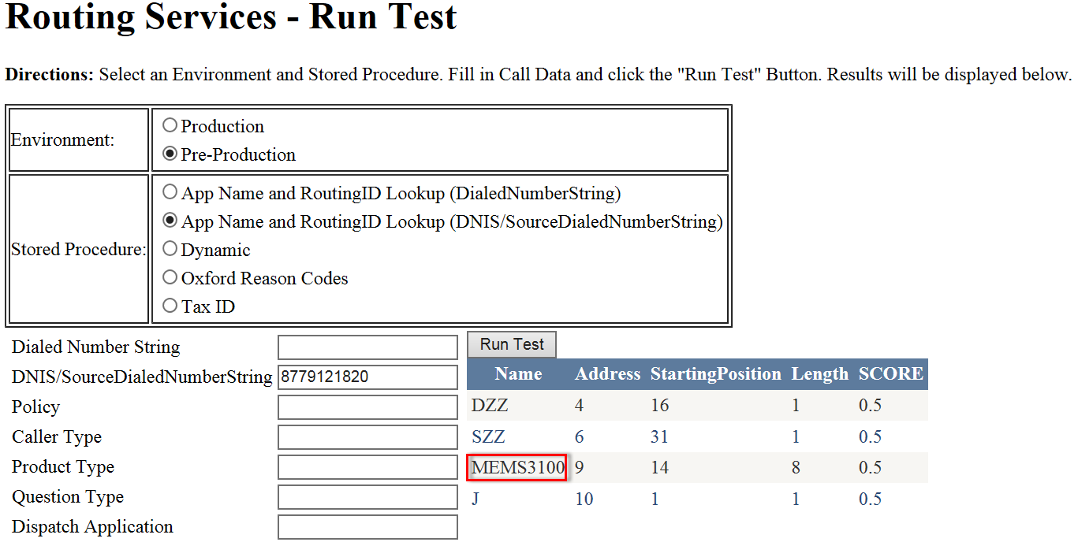
Routing Services App
https://cc/icm/ -- see ICM/Routing Services Training
The following shows a non-prod query for a TFN:

Slide 15

Q & A

